Slide 1
Presentation team Geodan
DB Hackathon 2015

Slide 2
Who?
Geodan http://www.geodan.nl
Tim Ebben (research department) tim.ebben@geodan.nl
Bert Temme (research department)
bert.temme@geodan.nl

Slide 3
What?
Incident Management Application for Control Room
https://github.com/Geodan/DBHackathon2015/
Features:
Intake incident
Visualize incident in map
Analyse incident
Notificate people

Slide 4
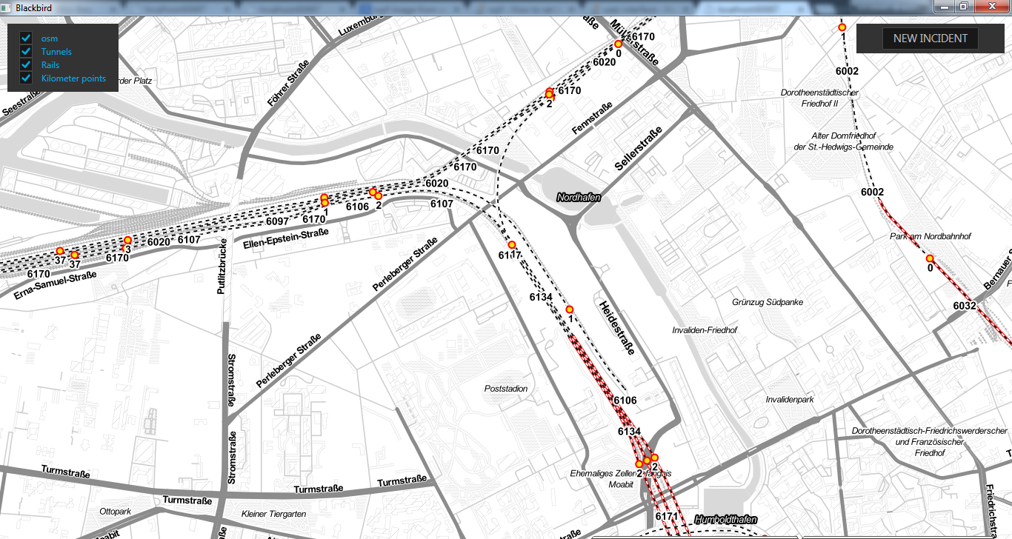
Screenshot 1

Slide 5
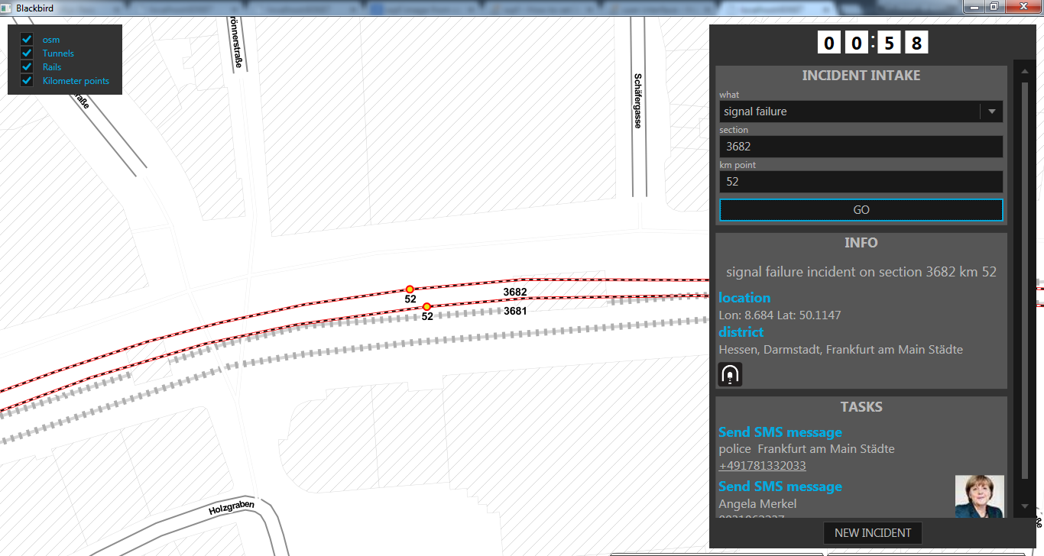
Screenshot 2

Slide 6
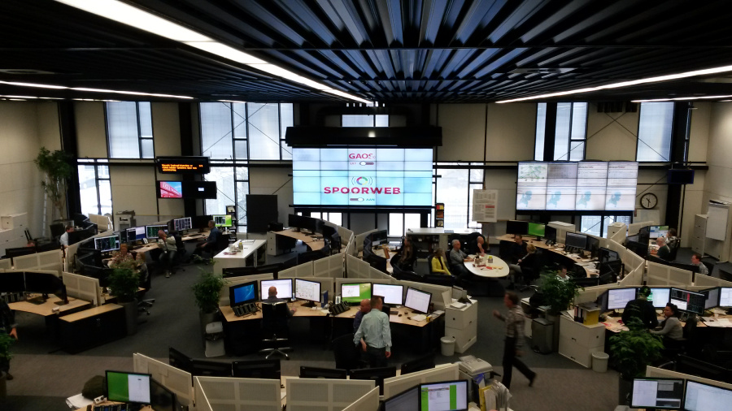
SpoorWeb at ProRail
More info: http://www.geodan.com/solutions/incident-management-system-prorail/

Slide 7
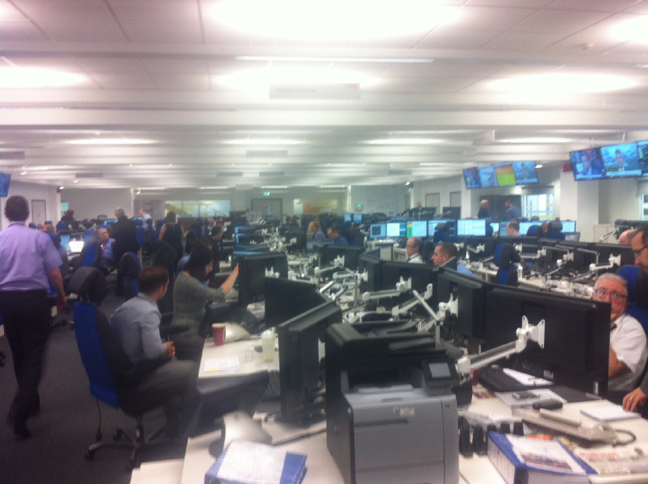
Spoorweb at Rail Operating Centre (ROC) in York

Slide 8
Why?
Fix incidents more quickly
Give people correct information what/where/when
Less delays -> reduce costs

Slide 9
How?
Create and fill database
Create DB Bahn REST API (JSON)
Create DBBahn mapservice
Create Incident Control Room application (desktop)

Slide 10
Data used
Bahnstrecken
Kilometerpoints
Tunnels
Data processing: Shape -> PostGIS

Slide 11
Architecture
Javascript
Android
IOS
Desktop
HTTP Request
JSON Response
OpenStreetMap
DB Bahn services
Geoserver
SMS service
Geocoder
Pinpoint
SQL
PostgreSQL (DB Bahn)

Slide 12
Techniques
Database: PostgreSQL + PostGIS
Webservices: ASP.NET Web API
Map: Geoserver
Desktop: WPF + Mapsui

Slide 13
Future improvements
Display more data
Extend intake form
Store incident information
Add more rules and notifications
More clients (mobile)

Slide 14
Demo!
Intake incident
Visualize incident
Send SMS notifications
Incident sample:
Bahnstrecke 1000 kilometerpoint 174
Incident tunnel sample
Bahnstrecke 6134 kilometerpoint 2

Slide 15
Thanks!
Tim Ebben
Tim.ebben@geodan.nl
www.twitter.com/timebben
Bert Temme
Bert.temme@geodan.nl
www.twitter.com/berttemme

